Slide 1
Runtime Environment
Procedural Abstraction
Notes:
%

Slide 2
Runtime Environment
Procedural Abstraction
Notes:
%

Slide 3
An Important Duality
Programming languages contain high-level structures:
Functions
Procedures
Classes and Objects
Variable and constants
Structures
Labels
Files etc…
The physical computer only operates in terms of several primitive operations (low-level):
Arithmetic
Data movement
Control jumps

Slide 4
Runtime Environments
We need to come up with a representation of these high-level structures using the low-level structures of the machine.
A runtime environment is a set of data structures maintained at runtime to implement these high-level structures.
e.g. the stack, the heap, static area, virtual function tables, etc.
It strongly depends on the features of both the source and target language.
By runtime, we mean a program in execution.
Runtime environment is a state of the target machine, which may include software libraries, environment variables, etc., to provide services to the processes running in the system.

Slide 5
Runtime Environment
Procedural Abstraction
Notes:
%

Slide 7
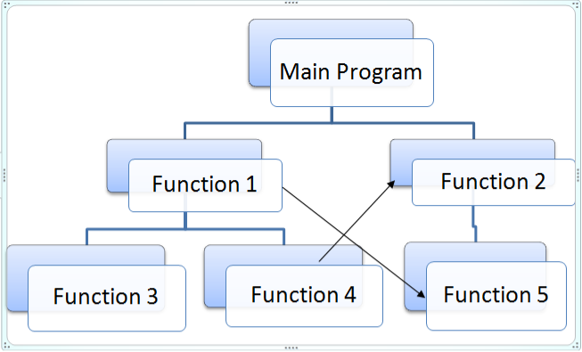
Procedure Abstraction
Introduction
The procedure is one of the central abstractions in most modern programming languages.
Procedures create a controlled execution environment; each procedure has its own private named storage.
The procedures are the basic unit of work for most compilers.
A typical compiler processes a collection of procedures and produces code for them that will link and execute correctly with other collections of compiled procedures.

Slide 8
Procedure Abstraction
Introduction
Each procedure has its own private named storage.
Statements executed inside the procedure can access the private, or local, variables in that private storage.
A procedure executes when it is invoked, or called, by another procedure (or the operating system).
The callee may return a value to its caller, in which case the procedure is termed a function.
This interface between procedures lets programmers develop and test parts of a program in isolation; the separation between procedures provides some insulation against problems in other procedures.

Slide 9
Procedure Abstraction
Introduction
Procedures play an important role in the way that programmers develop software and that compilers translate programs.
Three critical abstractions that procedures provide allow the construction of nontrivial programs.
Procedure Call Abstraction
Name Space
External Interface

Slide 10
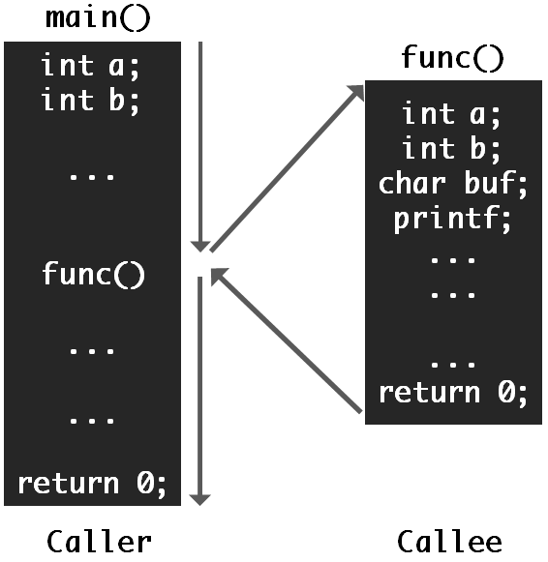
Procedure Abstraction
Introduction
Procedure Call Abstraction
Procedural languages support an abstraction for procedure calls.
Each language has a standard mechanism to invoke a procedure and map a set of arguments, or parameters, from the caller’s name space to the callee’s name space.
This abstraction typically includes a mechanism to return control to the caller and continue execution at the pointimmediately after the call.
Most languages allow a procedure to return one or more values to the caller.
The use of standard linkage conventions, sometimes referred to as calling sequences, lets the programmer invoke code written and compiled by other people and at other times; it lets the application invoke library routines and system services.

Slide 11
Procedure Abstraction
Introduction
2. Name Space
In most languages, each procedure creates a new and protected name space.
The programmer can declare new names, such as variables and labels, without concern for the surrounding context.
Inside the procedure, those local declarations take precedence over any earlier declarations for the same names.
The programmer can create parameters for the procedure that allow the caller to map values and variables in the caller’s name space into formal parameters in the callee’s name space.
Because the procedure has a known and separate name space, it can function correctly and consistently when called from different contexts.
Executing a call instantiates the callee’s name space.
The call must create storage for the objects declared by the callee.
This allocation must be both automatic and efficient—a consequence of calling the procedure.

Slide 12
Procedure Abstraction
Introduction
3. External Interface
Procedures define the critical interfaces among the parts of large software systems.
The linkage convention defines rules that map names to values and locations, that preserve the caller’s runtime environment and create the callee’s environment, and that transfer control from caller to callee and back.
It creates a context in which the programmer can safely invoke code written by other people.
The existence of uniform calling sequences allows the development and use of libraries and system calls.
Without a linkage convention, both the programmer and the compiler would need detailed knowledge about the implementation of the callee at each procedure call.

Slide 14
Procedure Abstraction
Procedure Calls
In programming language the procedures have a simple and clear call/return discipline.
A procedure call transfers control from the call site in the caller to the start of the callee; on exit from the callee, control returns to the point in the caller that immediately follows its invocation.
(c) Execution History
The call graph shows the set of potential calls among the procedures.
Executing Main can result in two calls to Fee: one from Foe and another from Fum.
The execution history shows that both calls occur at runtime.
(a) Example Pascal Program

Slide 15
Procedure Abstraction
Procedure Calls
(c) Execution History
Each call to Fee creates a distinct instance, or activation.
By the time that Fum is called, the first instance of Fee is no longer active. It was created by the call from Foe (event 3 in the execution history), and destroyed after it returned control back to Foe (event 4).
When control returns to Fee, from the call in Fum (event 6), it creates a new activation of Fee.
The return from Fee to Fum destroys that activation.
(a) Example Pascal Program

Slide 16
Procedure Abstraction
Procedure Calls
(c) Execution History
When the program executes the assignment x := 1 in the first invocation of Fee, the active procedures are Fee, Foe, Fie, and Main.
These all lie on a path in the call graph from Main to Fee.
Similarly, when it executes the second invocation of Fee, the active procedures (Fee, Fum, Foe, Fie, and Main) lie on a path from Main to Fee.
Pascal’s call and return mechanism ensures that, at any point during execution, the procedure activations instantiate some rooted path through the call graph..
(a) Example Pascal Program

Slide 17
Procedure Abstraction
Procedure Calls
When the compiler generates code for calls and returns, that code must preserve enough information so that calls and returns operate correctly.
Thus, when Foe calls Fum, the code must record the address in Foe to which Fum should return control.
Fum may diverge, or not return, due to a runtime error, an infinite loop, or a call to another procedure that does not return. Still, the call mechanism must preserve enough information to allow execution to resume in Foe.
The call and return behavior can be modelled with a stack.
Fie calls Foe, it pushes the return address in Fie onto the stack. When Foe returns, it pops that address off the stack and jumps to the address.

Slide 18
Procedure Abstraction
Procedure Calls
The stack mechanism handles recursion as well.
The call mechanism, in effect, unrolls the cyclic path through the call graph and creates a distinct activation for each call to a procedure.
As long as the recursion terminates, this path will be finite and the stack of return addresses will correctly capture the program’s behavior.
Consider the recursive factorial computation shown in Figure 6.2.
When invoked to compute (fact 5), it generates a series of recursive calls: (fact 5) calls (fact 4) calls (fact 3) calls (fact 2) calls (fact 1).
At that point, the cond statement executes the clause for (<= k 1), terminating the recursion.
The recursion unwinds in the reverse order, with the call to (fact 1) returning the value 1 to (fact 2). It, in turn, returns the value 2 to (fact 3), which returns 6 to (fact 4). Finally, (fact 4) returns 24 to (fact 5), which multiplies 24 times 5 to return the answer 120.
The recursive program exhibits last-in, first-out behavior, so the stack mechanism correctly tracks all of the return addresses.

Slide 19
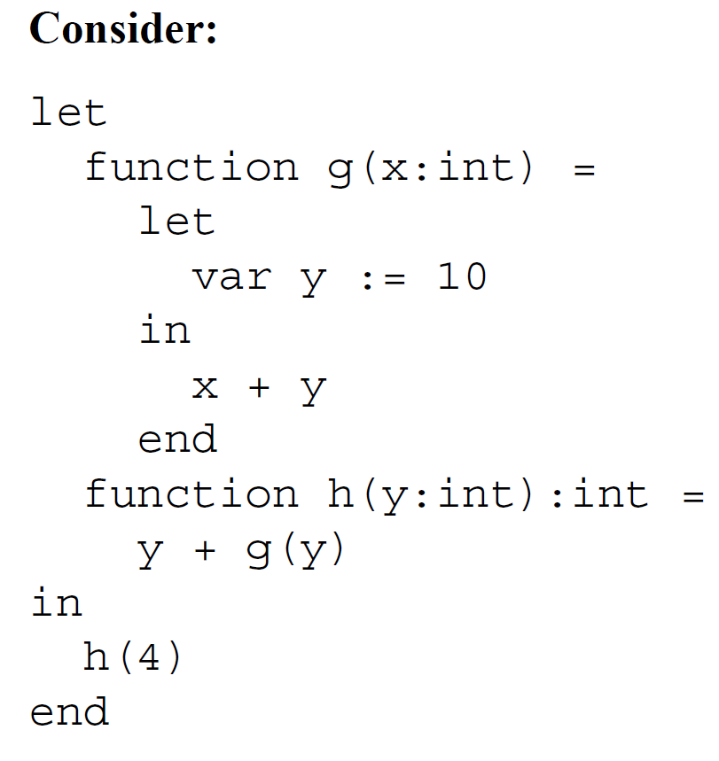
Example
Procedure Abstraction
Procedure Calls
h
g

Slide 20
Procedure Abstraction
Procedure Calls

Slide 23
Procedure Abstraction
Name Spaces
The name space, or scope, maps a set of names to a set of values and procedures over some set of statements in the code.
In most procedural languages, a complete program will contain multiple names spaces.
The range of a scope might be the whole program, some collection of procedures, a single procedure, or a small set of statements.
The scope may inherit some names from other scopes.
Inside a scope, the programmer can create names that are inaccessible outside the scope.
Some examples

Slide 24
Procedure Abstraction
Name Spaces
Nested Lexical Scopes
Most PLs allow the programmer to nest scopes inside one another.
The limits of a scope are marked by specific terminal symbols in the programming language. Eg. Begin …. End, { … }, etc.
In programs with nested procedures, each procedure defines a new scope, and the programmer can declare new variables and procedures in each scope.
lexical scoping.
This most common scoping discipline is called as lexical scoping.
The general principle behind lexical scoping is simple: “In a given scope, each name refers to its lexically closest declaration.”
Thus, if s is used in the current scope, it refers to the s declared in the current scope, if one exists. If not, it refers to the declaration of s that occurs in the closest enclosing scope.
The outermost scope contains global variables.

Slide 25
Procedure Abstraction
It contains five distinct scopes, one corresponding to the program Main and one for each of the procedures Fee, Fie, Foe, and Fum.
Each procedure declares some set of variables drawn from the set of names x, y, and z.
Name Spaces
Nested Lexical Scopes
The figure shows each name with a subscript that indicates its level number.
Names declared in a procedure always have a level that is one more than the level of the procedure name.
Thus, if Main has level 0, as shown, names declared directly in Main, such as x, y, z, Fee, and Fie all have level 1.

Slide 26
Procedure Abstraction
To represent names in a lexically scoped language, the compiler can use the static coordinate for each name.
The static coordinate is a pair <l, o>, where l is the name’s lexical nesting level and o is the its offset in the data area for level l.
Name Spaces
Nested Lexical Scopes
The second part of name translation occurs during code generation.
The compiler must use the static coordinate to locate the value at runtime.
Given a coordinate <l, o>, the code generator must emit code that translates l into the runtime address of the appropriate data area. Then, it can use the offset o to compute the address for the variable.

Slide 27
Scoping Rules
Procedure Abstraction
Name Spaces
DYNAMIC SCOPING
The alternative to lexical scoping is dynamic scoping.
The distinction between lexical and dynamic scoping only matters when a procedure refers to a variable that is declared outside the procedure’s own scope, (these variables are called as free variables).
With lexical scoping
a free variable is bound to the declaration for its name that is lexically closest to the use.
If the compiler starts in the scope containing the use, and checks successive surrounding scopes, the variable is bound to the first declaration that it finds.
With dynamic scoping
a free variable is bound to the variable by that name that was most recently created at runtime.
Thus, when execution encounters a free variable, it binds that free variable to the most recent instance of that name.

Slide 28
Lexical scoping vs dynamic scoping –Example 1
Procedure Abstraction
Name Spaces
Nesting relationship
Lexical scoping
a0()
x1
x1= 1
b1()
c1()
x2
b1()
------------------
a0 calls c1
x2
c1 calls b1
x1=2
Prints x1= 2
Dynamic scoping
a0()
x1
x1= 1
b1()
c1()
x2
b1()
---------------------
a0 calls c1
x2
c1 calls b1
x2=2
Prints x1= 1
Calling relationship
Program a()
{
x: integer;
x=1;
procedure b()
{
x=2;
}
procedure c()
{
x: integer;
b();
}
c();
print x;
}
Closest variable with same name for x is x2
Closest nesting structure

Slide 29
Lexical scoping vs dynamic scoping
Procedure Abstraction
Name Spaces
Nesting relationship
Calling relationship
(define m 50)
(define n 100)
(define (hardy)
(display (list "In Hardy, n=" n))
(newline))
(define (laurel n)
(display (list "In Laurel, m=" m))
(newline)
(display (list "In Laurel, n=" n))
(newline)
(hardy))
(laurel 1)
(hardy)
Dynamic scoping
in main0 program
m1 = 50, n1 = 100
In hardy (call from main)
m1 = 50, n1 = 100
In hardy (call from laurel)
m1 = 50, n2 = 1
In laurel
m1 = 50, n2 =1
Static scoping
in main0 program
m1 = 50, n1 = 100
In hardy (call from main)
m1 = 50, n1 = 100
In hardy (call from laurel)
m1 = 50, n1 = 100
In laurel
m1 = 50, n2 =1

Slide 30
Lexical scoping Vs dynamic scoping
Procedure Abstraction
Name Spaces
Nesting relationship
Nesting relationship
VAR count: INTEGER;
PROCEDURE procX
BEGIN
VAR count: INTEGER;
SET count TO 100;
CALL report
END
PROCEDURE procY
BEGIN
SET count TO 200;
CALL report
END
PROCEDURE report
BEGIN
PRINT “count =” + count
END
MAIN PROGRAM
BEGIN
SET count TO 300;
CALL procX;
CALL procY
END
int n = 1; // global
print_plus_n(int x)
{
cout << x + n;
}
increment_n()
{
n = n + 2;
print_plus_n(n);
}
test()
{
int n;
n = 200;
print_plus_n(7);
n = 50;
increment_n();
cout << n;
}
Calling relationship
Calling relationship
Static
8 ,6 and 50
Dynamic
207, 104, 52
Static
300, 200
Dynamic
100, 200

Slide 31
Lexical scoping vs dynamic scoping – Try it!!!
Procedure Abstraction
Name Spaces
begin
integer global, n;
procedure laurel(n: integer);
begin
procedure hardy;
begin
print(global);
print(n);
end;
if n<4 then laurel(n+1); else hardy;
end;
global := 99;
n := 100;
laurel(1);
end;
(define m 50)
(define n 100)
(define (hardy)
(display (list "In Hardy, n=" n))
(ncewline))
(define (laurel n)
(display (list "In Laurel, m=" m))
(newline)
(display (list "In Laurel, n=" n))
(newline)
(hardy))
n
(laurel 1)
(hardy)

Slide 32
Lexical scoping vs dynamic scoping – Try it!!!
Procedure Abstraction
Name Spaces
begin
procedure test(n: integer, p: procedure);
begin
procedure rose;
begin
print("in procedure rose -- n=");
print(n);
end;
print("in procedure test -- n=");
print(n);
P;
if n<10 then
begin
if n=3 then
test(n+1,rose)
else test(n+1,p)
end
end;
procedure violet;
begin
print("in procedure violet");
end;
test(1,violet);
end;

Slide 33
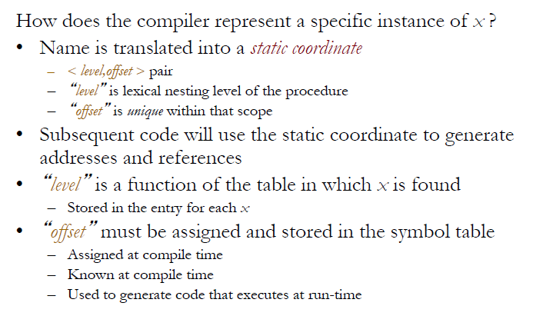
Nested Lexical Scope - translating local names
Procedure Abstraction
Name Spaces
In a given scope, each name refers to its lexically closest declaration.

Slide 34
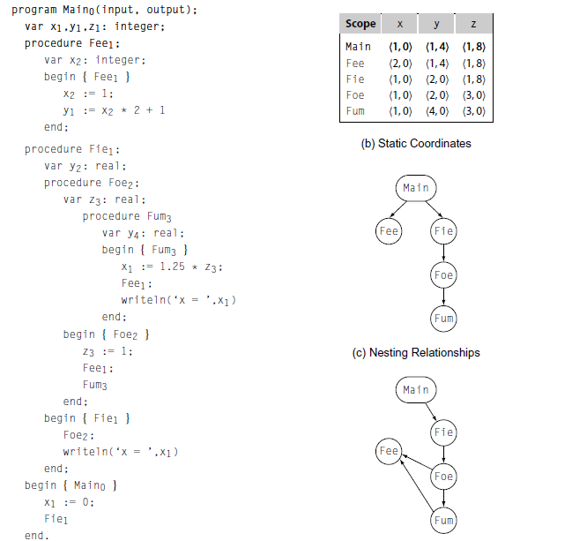
Nested Lexical Scopes
Procedure Abstraction
Name Spaces
(a) Pascal Program
(d) Calling Relationships

Slide 36
Procedure Abstraction
Runtime Structures
To implement the twin abstractions of procedure calls and scoped name spaces, the translation must establish a set of runtime structures.
The key data structure involved in both control and naming is the activation record (AR), a private block of memory associated with a specific invocation of a specific procedure.
In principle, every procedure call gives rise to a new AR.
(1) For each call, the compiler must arrange to store the return address - it is stored in AR.
(2) The compiler must map the actual parameters to the formal parameter names – the parameter information is stored in AR.
(3) The compiler must create storage space for variables declared in the callee’s local scope – they are stored in AR.
(4) The callee needs other information to connect it to the surrounding program, and to allow it to interact safely with other procedures – these information stored in the callee’s AR.

Slide 37
Procedure Abstraction
Runtime Structures
The ARs in Figure 6.4 have a number of fields.
The parameter area holds actual parameters from the call site, in an order that corresponds to their order of appearance at the call.
The register save area contains enough space to hold registers that the procedure must preserve due to procedure calls.
The return-value slot provides space to communicate data from the callee back to the caller, if needed.
The return-address slot holds the runtime address where execution should resume when the callee terminates.
The “addressability” slot holds information used to allow the callee to access variables in surrounding lexical scopes (not necessarily the caller).
The slot at the callee’s ARP stores the caller’s ARP. The callee needs this pointer so that it can restore the caller’s environment when it terminates.
The local data area holds variables declared in the callee’s local scope.
Figure 6.4 shows contents of an AR.
The AR is addressed through an activation record pointer (arp).
The fields in the AR found at positive and negative offsets from the ARP.

Slide 39
Procedure Abstraction
Communicating value between procedures
The callee executes, using the formal parameter names to access the values passed as actual parameters.
If the programmer desires, the procedure can return a result.

Slide 40
Procedure Abstraction
Communicating value between procedures
6.4.1 Passing Parameters
Parameter binding maps the actual parameters at a call site to the callee’s formal parameters.
Most modern programming languages use one of two conventions for mapping actual parameters to formal parameters:
call-by-value binding and
call-by-reference binding.

Slide 41
Procedure Abstraction
Communicating value between procedures
6.4.1 Passing Parameters
Call by Value
Call by value a convention where the caller evaluates the actual parameters and passes their values to the callee.
Any modification of a value parameter in the callee is not visible in the caller.
Consider the following procedure, written in c, and several call sites that invoke it:
The three invocations produce the following results when invoked using call-by-value parameter binding:
If the callee changes its value, that change is visible inside the callee, but not in the caller.
One variation on call-by-value binding is call-by-value-result binding.
In this scheme, the values of formal parameters are copied back into the corresponding actual parameters as part of the process of returning control from the callee to the caller.

Slide 42
Procedure Abstraction
Communicating value between procedures
6.4.1 Passing Parameters
Call by reference
With call-by-reference parameter passing, the caller stores a pointer in the AR slot for each parameter.
If the actual parameter is a variable, it stores the variable’s address in memory.
Inside the callee, each reference to a call-by-reference formal parameter needs an extra level of indirection.
Call by reference differs from call by value in two critical ways.
(1) First, any redefinition of a reference formal parameter is reflected in the corresponding actual parameter.
(2) Second, any reference formal parameter might be bound to a variable that is accessible by another name inside the callee.

Slide 43
Procedure Abstraction
Communicating value between procedures
6.4.1 Passing Parameters
Call by reference
With call-by-reference parameter binding, the example produces different results.
The first call is straightforward.
The second call redefines both a and b; those changes would be visible in the caller.
The third call causes x and y to refer to the same location, and thus, the same value.
This alias changes fee’s behavior.
The first assignment gives a the value 4. ( x = 2 + 2 = 4)
The second assignment then gives a the value 8, and fee returns 8. (y = 4 + 4 = 8)
(where fee(2,2) will return 6, if call by value)

Slide 44
Procedure Abstraction
Communicating value between procedures
6.4.2 Returning Values
To return a value from a function the compiler must set aside space for the returned value.
Because the return value is used after the callee terminates, it needs storage outside the callee’s AR.
It can store the value either in the caller’s AR or in a designated register.
The caller allocates space for the returned value in its own AR, and stores a pointer to that space.
The callee can load that pointer and use it to access the storage and set the returned value in caller’s AR.

Slide 45
Procedure Abstraction
Communicating value between procedures
6.4.3 Establishing Addressability
As part of the linkage convention, the compiler must ensure that each procedure can generate an address for each variable that it needs to reference.
In an ALL, a procedure can refer to global variables, local variables, and any variable declared in a surrounding lexical scope.
In general, the address calculation consists of two portions:
(1) finding the base address of the appropriate data area for the scope that contains the value, and
(2) finding the correct offset within that data area.
The problem of finding base addresses divides into two cases:
(1) data areas with static base addresses and
(2) those whose address cannot be known until runtime.
Eg. X = Y + Z

Slide 46
Procedure Abstraction
Communicating value between procedures
6.4.3 Establishing Addressability
Variables with Static Base Addresses
To get the address of a variable : “compute the data area’s base address into a register” and “add its offset to the base address”
Variables with Dynamic Base Addresses
Local variables declared within a procedure are typically stored in the procedure’s AR.
Thus, they have dynamic base addresses.
To get the address of a variable: “compiler need to find the address of the AR, and then find it”

Slide 48
Procedure Abstraction
Standard Linkages
Self Study

Slide 49
The End………

